Slide 1

ECE 530 Cloud Computing
Ioannis Papapanagiotou
Fundamentals of Cgroups

Slide 2
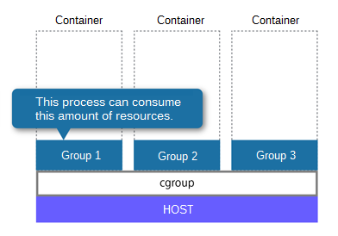
Is containers a new thing?
Cgroups is a mechanism to control resources per hierarchical groups of processes
cgroups (abbreviated from control groups) is a Linux kernel feature to limit, account, and isolate resource usage (CPU, memory, disk I/O, etc.) of process groups.
This work was started by engineers at Google in 2006 under the name "process containers".
In late 2007, it was renamed to "Control Groups" due to the confusion caused by multiple meanings of the term "container" in the Linux kernel, and merged into kernel version 2.6.24.
Since then, new features and controllers have been added.
Notes:
(primarily Paul Menage and Rohit Seth)

Slide 3
Cgroups design goals
Provide a unified interface to many different use cases, from controlling single processes to whole operating system-level virtualization
Cgroups provides:
Resource limitation: groups can be set to not exceed a set memory limit — this also includes file system cache.
The original paper was presented at Linux Symposium and can be found at Containers: Challenges with the memory resource controller and its performance.
Prioritization: some groups may get a larger share of CPU or disk I/O throughput.
Accounting: to measure how much resources certain systems use for e.g. billing purposes.
Control: freezing groups or check-pointing and restarting.
Notes:
(as provided by OpenVZ, Linux-VServer or LXC, for example).

Slide 4
Namespaces
The purpose of each namespace is to wrap a particular global system resource in an abstraction that makes it appear to the processes within the namespace that they have their own isolated instance of the global resource.
Cgroups vs namespaces
Cgroups: limits how much you can use
Namespaces: limits how much you can see (and use)
Namespaces
mnt
uts
ipc
net
pid
usr

Slide 5
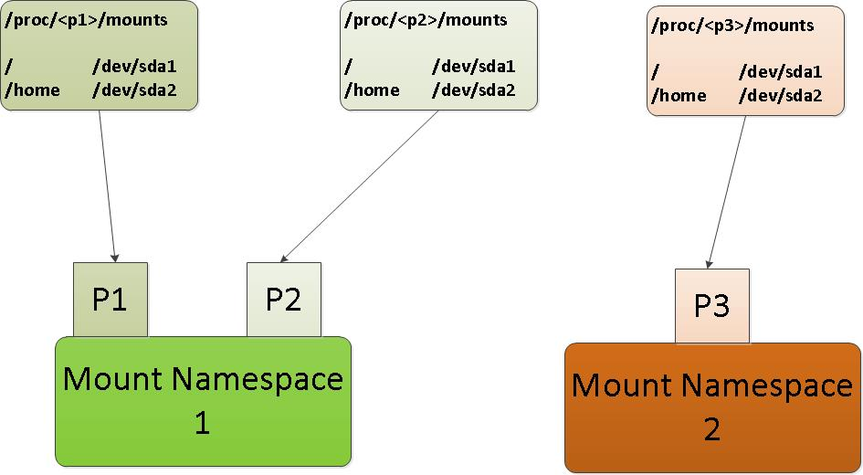
Mount Namespace
The “mount namespace” isolates the set of filesystem mount points seen by a group of processes
processes in a different mount namespaces can have different view of the filesystem hierarchy.
Mounts can be private or shared
The tasks running in each mount namespace doing mount/unmount will not affect the file system layout of the other mount namespace.
Notes:
Mount namespaces (CLONE_NEWNS, Linux 2.4.19) isolate the set of filesystem mount points seen by a group of processes. Thus, processes in different mount namespaces can have different views of the filesystem hierarchy. With the addition of mount namespaces, the mount() and umount() system calls ceased operating on a global set of mount points visible to all processes on the system and instead performed operations that affected just the mount namespace associated with the calling process.
One use of mount namespaces is to create environments that are similar to chroot jails. However, by contrast with the use of the chroot() system call, mount namespaces are a more secure and flexible tool for this task. Other more sophisticated uses of mount namespaces are also possible. For example, separate mount namespaces can be set up in a master-slave relationship, so that the mount events are automatically propagated from one namespace to another; this allows, for example, an optical disk device that is mounted in one namespace to automatically appear in other namespaces.
Mount namespaces were the first type of namespace to be implemented on Linux, appearing in 2002. This fact accounts for the rather generic "NEWNS" moniker (short for "new namespace"): at that time no one seems to have been thinking that other, different types of namespace might be needed in the future.

Slide 6
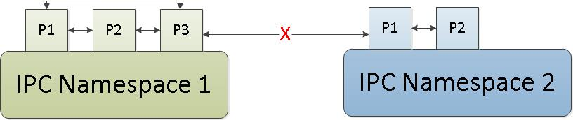
IPC Namespace
IPC namespace isolates the inter-process communication resources.
A process or a group of processes have their own:
IPC shared memory
IPC semaphore
IPC message queues

Slide 7
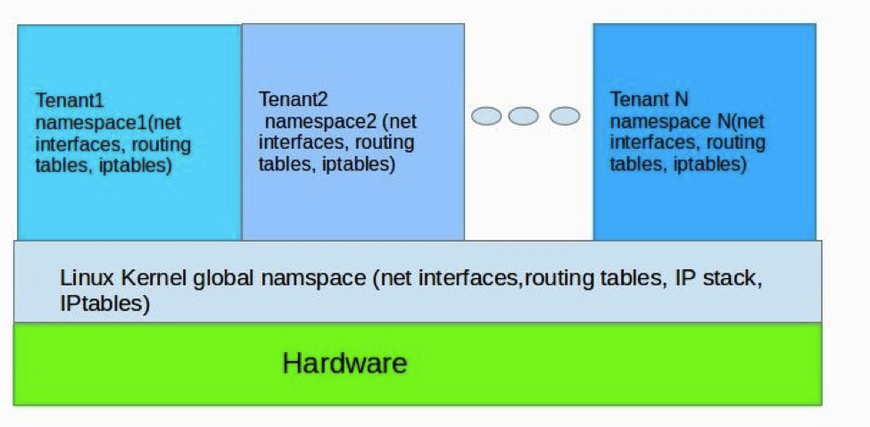
Network Namespace
Net namespace isolates the networking related resources
Every net namespace has independent
Network devices, IP addresses, firewall rules, routing table, sockets etc.
Notes:
The proc and sysfs interface of net namespace has been virtualized too.

Slide 8
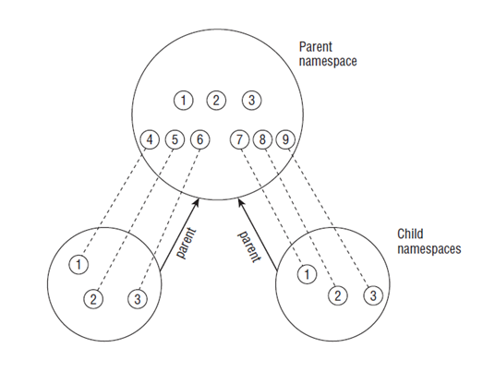
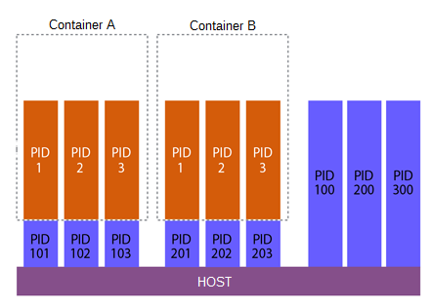
PID Namespace
PID namespace isolates the Process ID, implemented as a hierarchy.
PID namespace is a hierarchy comprised of “Parent” and “Child”.
The parent pid-ns can have many children pid-ns. Each Child pid-ns only has one parent pidns.
Notes:
The Pid namespace isolates the Process ID
Pid namespace is a hierarchy comprised of “Parent” and “Child”. The parent pidns can have many children pidns. Each Child pidns only has one parent pidns.
In the creation process tasks are created. Each task is allocated one pid in one pid namespace. Furthermore, a task is also allocated to each pid in parent and ancestor pid namespaces.
The Parent pid namespace can access this Task through the pid allocated to the parent pid namespace.
Every pid namespace has a level Value - n, used for marking the level of each pid namespace. The level of init_pid_ns is 0，it’s children pid namespace’s level is 1，the level of each grandchild is 2.
Because the processes in the child pid namespace will allocate a pid to the ancestor pid namespace,the kernel limits the max level to MAX_PID_NS_LEVEL(32)
/proc/<pid> has also been virtualized.
Please note that in the graphic we also have P2!
What this ,means is that each Parent and Child can have its own PID – PID:1 for the Child1 and PID:2 for the Parent
P3 is the same as P2, it also has two PID’s. PID:1 for the Child2 and PID:3 for the Parent.
The Child Namespace2 has one task that is made up of the proc and the Parent PID Namespace has 4 tasks – Tasks 1, 2, 3, and 4
The Parent PID ns can access the Task P2 through PID2

Slide 9
Other Namespaces
UTS namespace
UTS = UNIX Time-sharing System
Each process has a separate copy of the hostname and the (now mostly unused) NIS domain name → isolation!
In containers: useful for init and config scripts that tailor their actions based on the names
User namespace
kuid/kgid: Original uid/gid, Global
uid/gid: user id in user namespace, will be translated to kuid/kgid finally
Only parent User NS has rights to set map
Notes:
Before I begin to explain the User Namespace, I would like to explain the KUID and KGID
KUID: means the Kernel User ID. Before we have the User Namespace we us the UID.
KGID: Is the same as KUID but it is the Kernel Group ID.
UID: will only be used in the User Namespace
User namespace has two private proc files /proc/pid/uid_map and gid_map.
These two files can be used for setting the mapping table of the user namespace.
uid_map and gid_map contain multiple lines, The format of each line is “user_uid kernel_uid count”.

